Slide 1

NETWORK ADDRESS TRANSLATION [NAT]
Presenter: MN. Sihanas
Lecturer: Mr. Mohamed Nismy

Slide 2
Key Points before we begin.
NAT enables private IP addresses to communicate over public networks.
Helps conserve IP addresses and enhances security.
Main types: Dynamic NAT, Static NAT, and Port Address Translation (PAT).

Slide 3
Dynamic NAT
Maps private IPs to a pool of public IPs.
Public IPs are assigned temporarily, as needed.
Commonly used in networks with fluctuating demand.

Slide 4
Static NAT
One-to-one mapping between private and public IPs.
Provides permanent, predictable IP mapping.
Ideal for hosting services accessible from the internet.

Slide 5
Port Address Translation {PAT}
Allows multiple devices to share a single public IP.
Differentiates connections using unique port numbers.
Maximizes IP address utilization, supporting numerous devices.

Slide 6
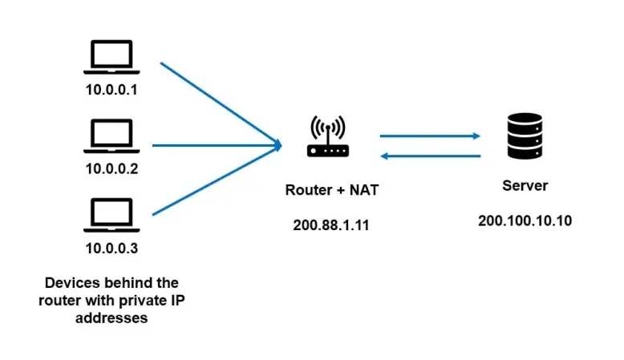
How it works?

Slide 7
Comparison of NAT Types
Feature | Dynamic NAT | Static NAT | PAT (Port Address Translation)
IP Mapping | Pool of public IPs | One-to-one mapping | One public IP shared by multiple private IPs
Assignment | Temporary, as needed | Permanent, fixed | Distinguishes devices by unique port numbers
Best For | Networks with variable demand | Services that need consistent public accessibility | Networks with many devices, high IP efficiency
IP Conservation | Moderate | Low (requires dedicated public IP for each device) | High (many devices share a single public IP)
Security Level | Moderate | Predictable, limited to mapped devices | High, as connections are port-specific

Slide 8
Thanks!
Any doubt?

